Slide 1
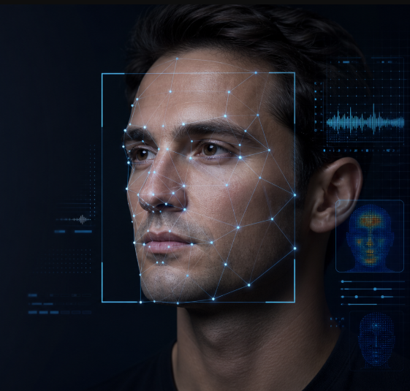
In The Name of God
Deepfake Detection
University of Tehran| Data Science
Mohammad Javad Sharifi
Mohammad Sadegh Mahdavipoor
Mohammad Mahdi Eghlimi
1

Slide 2



The Deepfake Problem
Real vs. Fabricated
What Are Deepfakes?
Synthetic media created using deep learning to manipulate or fabricate video and image content — indistinguishable to the human eye.
Why It Matters
Security threats, large-scale misinformation, and a fundamental erosion of trust in digital media integrity.
Our Focus
Image-based deepfake detection using both classical machine learning and deep learning architectures.
Deepfakes exploit generative models to swap, alter, or synthesize facial features with near-photorealistic fidelity.
2

Slide 3




Project Workflow: Three Phases
From raw data collection to final inference pipeline
Phase 1: Dataset
Phase 2: Preprocessing & EDA
Phase 3: Training & Inference
Source: leveraged a high-quality , pre-labaled Deepfake data set from Kaggle
Structure: Utilized standardized Train , Validation and Test partitions for unbiased evaluation
Normalization, augmentation, resizing, and exploratory data analysis for quality and balance verification.
Model training across SVM, Random Forest, VGG, ResNet and CNN ,followed by inference pipeline deployment.
Phase 1
Data
Phase 2 Prepration
Phase 3
Model
3

Slide 4
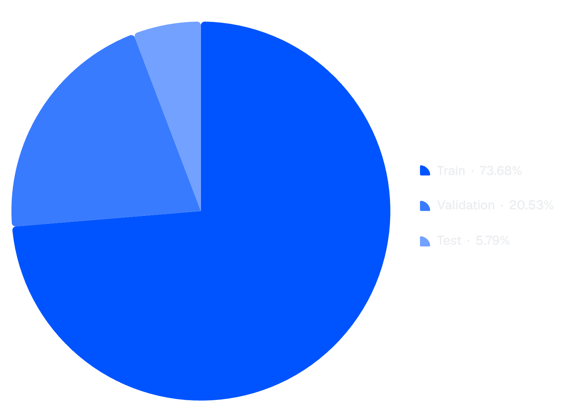
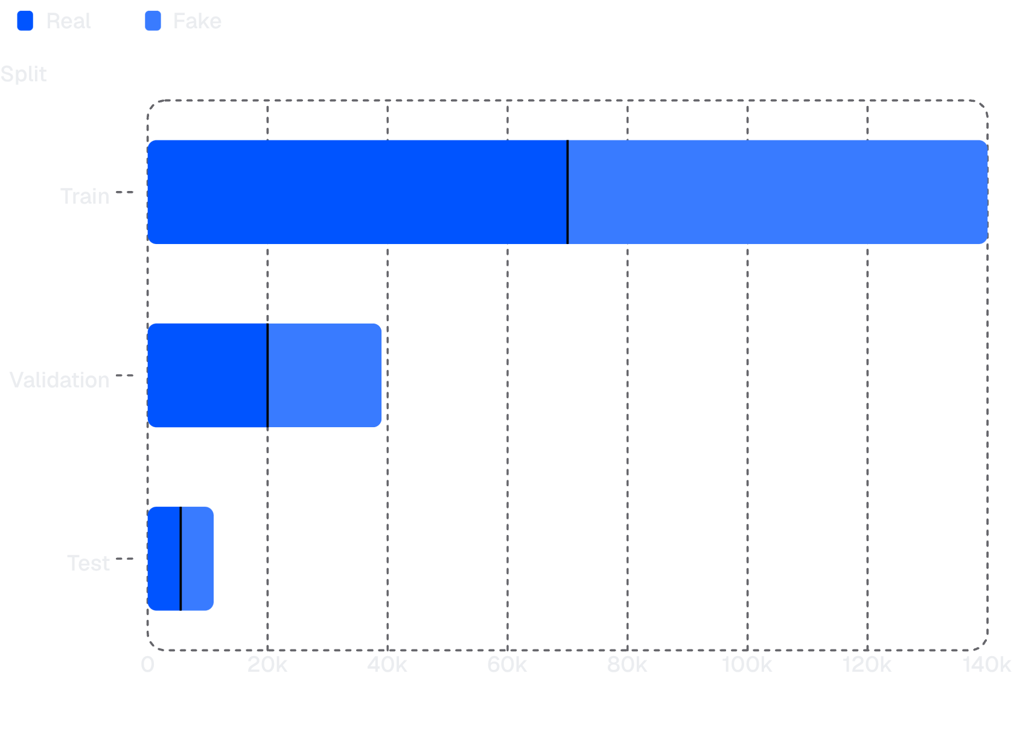
Phase 1: Dataset Overview
Dataset Splits at a Glance
140K
Training Images
70K Real / 70K Fake — perfectly balanced split for unbiased model training.
39K
Validation Images
~20K Real / 19K Fake — used for hyperparameter tuning and early stopping.
11K
Test Images
5.5K Real / 5.5K Fake — held-out set for final performance evaluation.
4

Slide 5




Phase 2: Database Creation ,Preprocessing & EDA
Making Database
Preprocessing
Exploratory Data Analysis
Infrastructure: Lightweight SQLite engine for fast , serverless metadata management
Apply pixel normalization (0–1 scaling), geometric augmentation (flips, rotations), and uniform resizing for all inputs.
Analyze class distribution, verify label balance, assess image quality, and identify potential sources of bias or noise.
EDA confirmed near-perfect class balance across all splits — no resampling required prior to model training.
5

Slide 6




Data Downsampling & Resolution Standardization
Dataset Downsampling (Dataset Level)
Image Preprocessing (Image Level)
Full Dataset
Native Resolution
1
~190,000 raw images — complete acquisition corpus
256×256 px — uniform across entire dataset
Stratified Sampling
Target Resizing
Preserved Real/Fake ratios & Train/Val/Test proportions
2
224×224 px for ResNet/VGG | 128×128 px for SimpleCNN
Development Subset
10,001 images — seed=42 for reproducibility
Normalization
3
RGB channels: mean=0.5, std=0.5 — zero-centered inputs
Quality Check
Zero corrupted BLOBs detected across all splits
Model Input
4
Tensors ready for training pipeline ingestion
6

Slide 7






Phase 3: Model Training & Inference Pipeline
Multiple architectures trained in parallel, evaluated on identical held-out data for fair comparison
Model Training
Inference Pipeline
Input Image
Raw image ingested from file system or live stream.
SVM
Random Forest
Preprocessing
Resize, normalize, and format tensor for model input.
VGG
ResNet
Model Prediction
Forward pass through trained model to obtain class probabilities.
CNN
Output: Real / Fake
Binary classification label returned with confidence score.
7

Slide 8
Classical Models: SVM & Random Forest
Baseline machine learning models establishing minimum performance thresholds for comparison
Support Vector Machine (SVM)
Random Forest (RF)
66.76%
66.01%
Accuracy
Accuracy
Overall correct classification rate on the held-out test set.
65.00%
66.10%
Precision
Precision
Ratio of true positives among all predicted fake samples.
73.24%
68.03%
Recall
Recall
Coverage of actual fake images correctly identified by the model.
Model
Hyper parameters
SVM
C=1.0, max_iter=2000, PCA(n=100)
Random Forest
n_estimators=100, PCA(n=100)
8

Slide 9
Deep Learning Models: VGG & ResNet
Deep neural networks leveraging convolutional feature hierarchies for artifact-level detection
VGG Architecture
ResNet Architecture
79.00%
79.84%
Accuracy
Accuracy
72.23%
73.33%
Precision
Precision
97.17%
94.62%
Recall
Recall
Model
Hyper parameters
VGG
batch=64, epochs=5+5, input=224×224, dropout=0.5, Adam, lr=1e-3 → 1e-5/1e-4
ResNet
batch=64, epochs=5+5, input=224×224, dropout=0.5, Adam, lr=1e-3 → 1e-5/1e-4
9

Slide 10

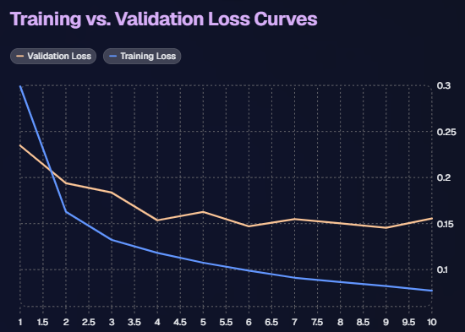

BEST MODEL
Best Model: CNN with Optimal Performance
Convolutional Neural Network achieved superior results across all evaluation metrics
CNN — Best Model
90.2%
Accuracy
88.45%
Precision
93.2%
Recall
Hyperparameters
Input=128×128 | Batch=64 | Epochs=10 | Adam(lr=1e-3) | Dropout=0.5
CNN outperformed all classical and deep baselines — recommended for production deployment.
10

Slide 11

Model Comparison – Why CNN Performs Best
vs. SVM & Random Forest: Better spatial pattern learning and hierarchical feature extraction unsuitable for classical ML.
vs. ResNet: Optimal architecture-to-dataset fit; ResNet's depth causes overfitting on this dataset size.
vs. VGG: Fewer parameters, faster convergence, better generalization without sacrificing accuracy.
11

Slide 12
Next Steps & Future Enhancements
Leveraging the optimal CNN model for deployment and exploring advanced detection frontiers.
Immediate Deployment & Iteration
Advanced Research & Development
Real-time Integration
Multimodal Detection
Deploy the trained CNN model into a real-time deepfake detection pipeline for immediate threat assessment.
Investigate integrating audio and contextual cues alongside visual analysis for a more robust detection system.
Continuous Monitoring & Retraining
Adversarial Robustness
Establish feedback loops for performance monitoring and periodic retraining with new deepfake datasets to maintain efficacy.
Research and implement techniques to enhance the model's resilience against adversarial attacks designed to bypass detection.
Explainable AI (XAI)
Develop methods to provide transparent insights into the model's decisions, increasing user trust and understanding.
12

Slide 13
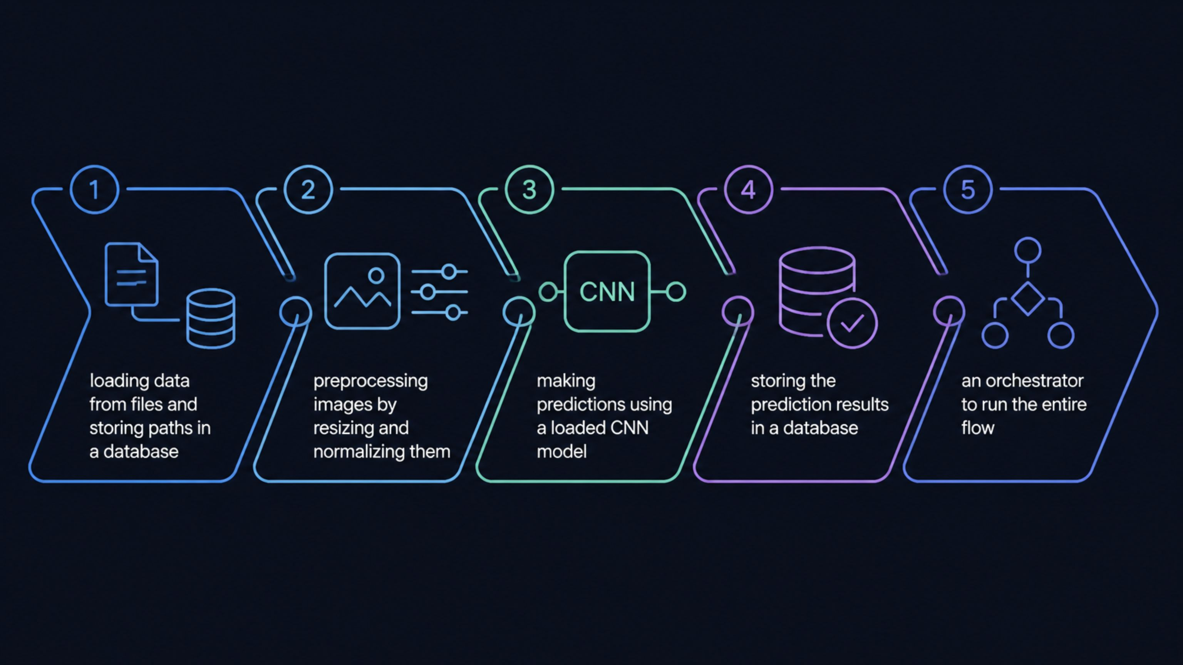





Inference Data Pipeline – Roadmap
End-to-end flow from test images to stored predictions (Real/Fake).
load_data.py
preprocess.py
make_predictions.py
Collect test image paths from ./dataset/test/Real and ./dataset/test/Fake. Store paths in source_data.db → raw_test_data (avoid duplicates).
Open image, convert to RGB, resize to 128×128. Convert to tensor, normalize (mean=0.5, std=0.5), shape 1×3×128×128.
Load SimpleCNN (3 Conv blocks + classifier). Use simple_cnn.pth to predict Fake vs Real.
predictions.py
run_pipeline.py
Store results in predictions_results.db → inference_results. Save image_path with predicted_label.
Orchestrator: run full flow (load → preprocess → predict → save).
13

Slide 14

Deepfake in the Real World & Industry
Where Deepfakes are used — and why detection is critical.
Media & Social Networks
Cybersecurity & Fraud
Manipulated celebrity images and viral misinformation.
Identity spoofing, fake profile images, impersonation.
Entertainment & Film Industry
Industrial / Enterprise Use
Face replacement and visual effects in movies.
Synthetic data and simulations, with risk of misuse.
14

Slide 15

Git Workflow & Version Control
Project tracked with Git repository.
Commits documenting pipeline phases and model experiments.
Branching used for experimenting with different models.
15
[PLACEHOLDER: future screenshot of Git log / commits / branch structure]

Slide 16
Conclusion
Our Deepfake Detection pipeline combines robust data processing and a tuned CNN model to reliably distinguish Real from Fake images.
Thank you for your attention.
16

